Slide 1

AI Challenge
Presented by :
Tudo Bein
Members of the group :
João Regazzi
Guilherme Mertens
Lucas Tramonte
Arthur Vogels
Rebecca Bayssari
Presented to :
Geraud Faye
Jean-Philippe Poli
Notes:
Tramonte

Slide 2
Context
Context
1- Dataset Analysis
2- Overview
3- Pipeline
4- Models
5- Evaluation and results
6- Improvements
Notes:
Tramonte

Slide 3



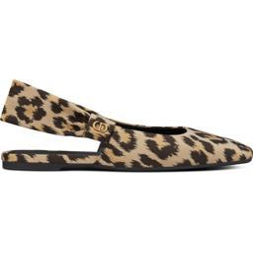
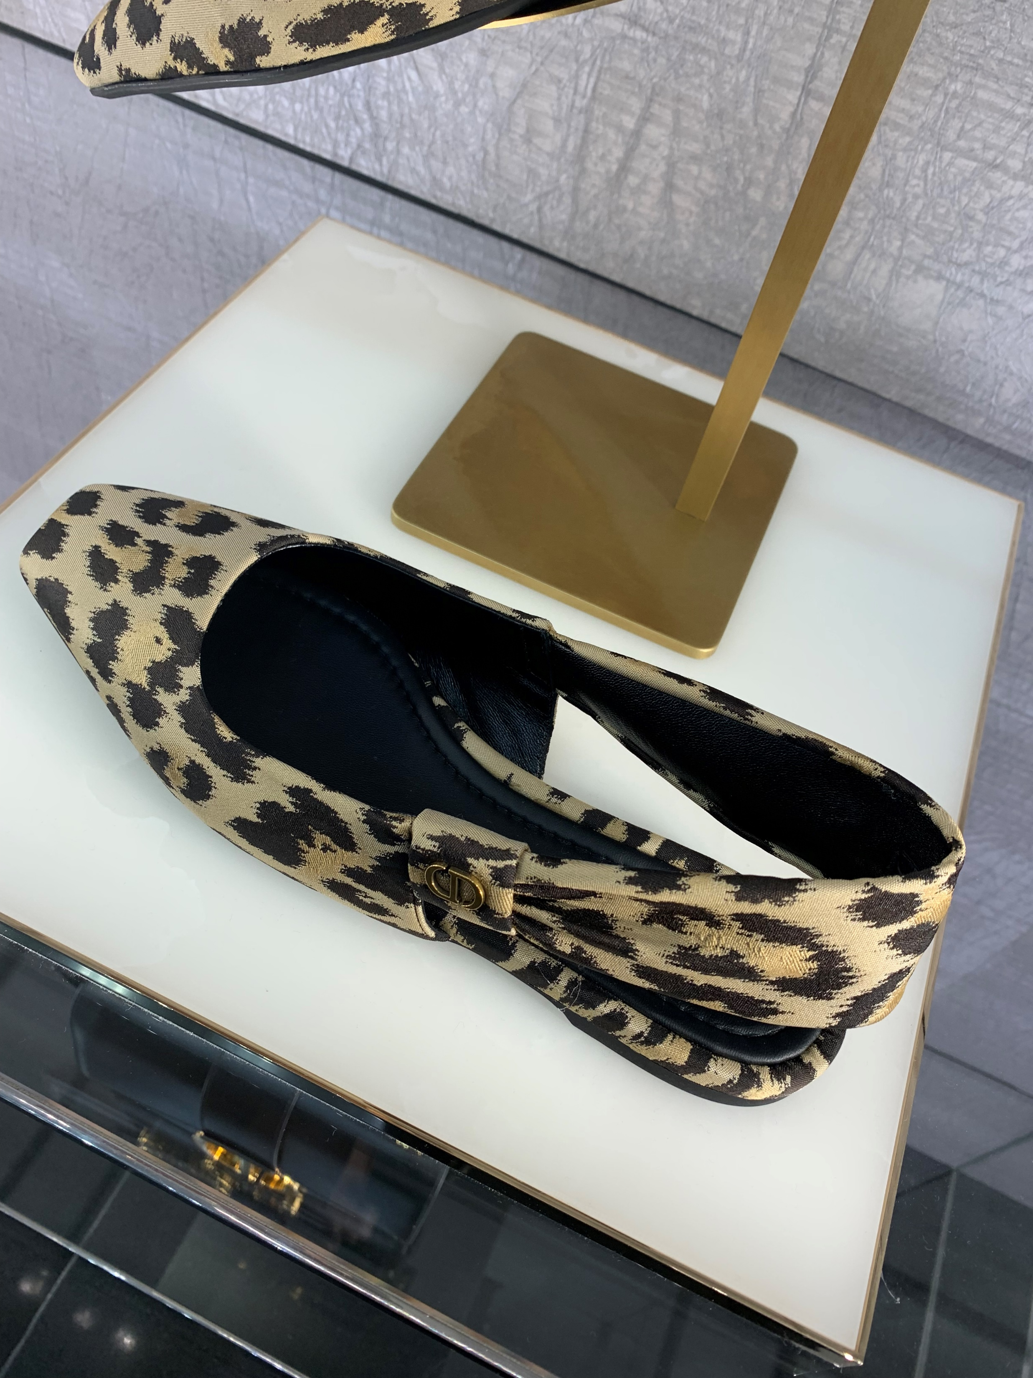
Dataset
Analysis
DAM training Dataset
Test image Dataset
Limited to one image per class
Uniform Background: Mostly white backgrounds
Diverse backgrounds (different places, stores)
Real-world variability and complexity
One shot Learning Challenge
Definition: Learning from just one example per class
Approach: Train a model to learn semantic representations of the images and compare them with similarity measures
Notes:
Tramonte

Slide 4
Problem
Overview
Train Data ≠ Test Data (Background & Image Capture Differences) →
Preprocessing steps applied
Background Removal – to standardize image conditions
Color Retrieval (For Bags / Shoes / Clothes)
1 Image per Class →
Leads to the use of:
CNN-based Models with contrastive learning
(e.g., ResNet variants) for feature extraction
CLIP Models
for semantic representation of the data
Data Augmentation
Notes:
Tramonte

Slide 5
Pipeline
1-Embeddings Extract feature embeddings from DAM images and test images Images are transformed into a shared semantic space for comparison space
2-Cosine Similarity
Compute cosine similarity between each test image and DAM reference images.
Measures how visually close the test image is to the reference images from
the DAM dataset.
3-Top-5 / Top-10 Matching
Higher-ranked matches have stronger feature similarities
Notes:
Guilherme

Slide 6
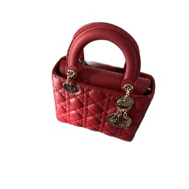
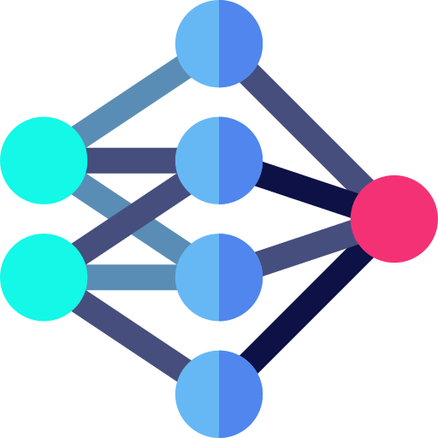
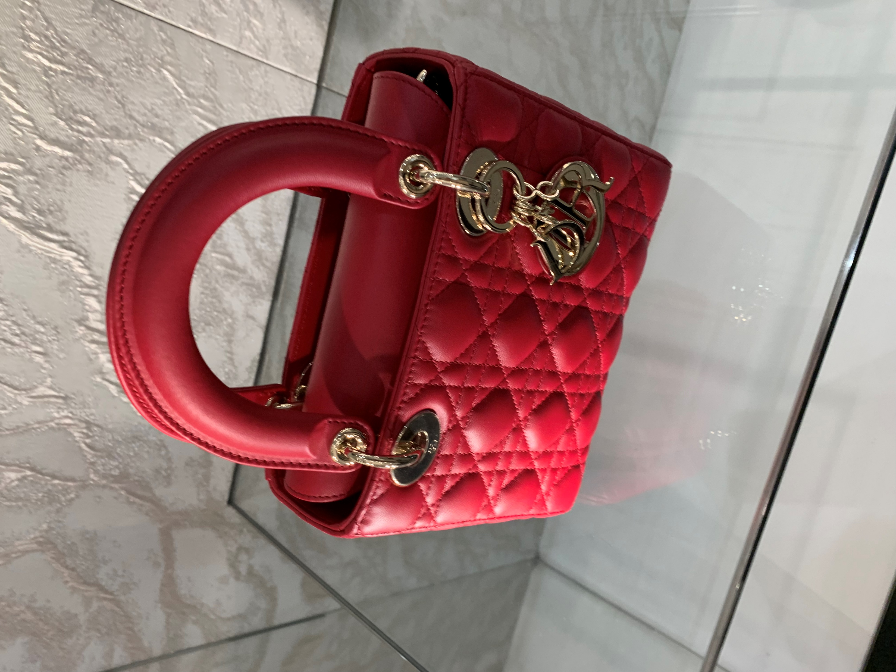
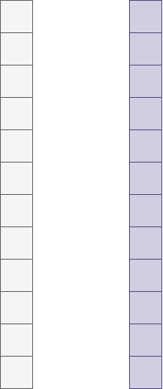


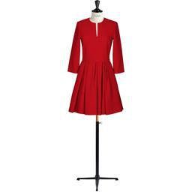
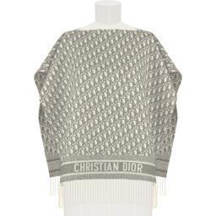
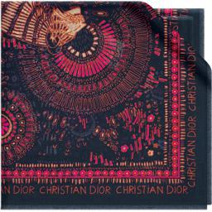
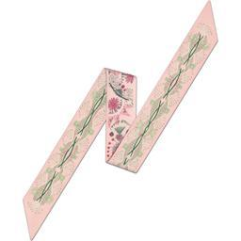
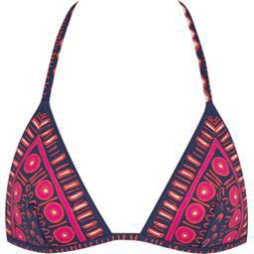
Pipeline
Features extractor
Preprocessing
Cosine
Similarity
Features extractor
Notes:
Guilherme

Slide 7

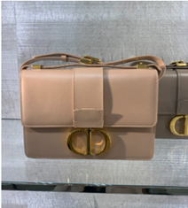
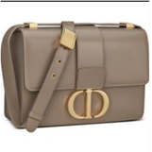
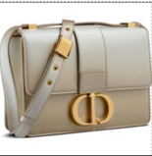
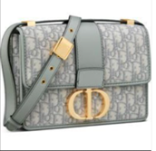

Image Embedder using pretrained Resnet Backbones
Test the pipeline with a simple, pretrained model
Use of Resnet50 pretrained on ImageNet with no finetuning
Those embeddings are not optimized for classification of unseen classes, leading to not so great results
Notes:
Arthur

Slide 8
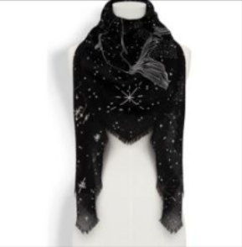
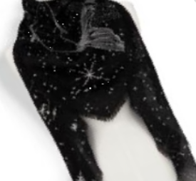
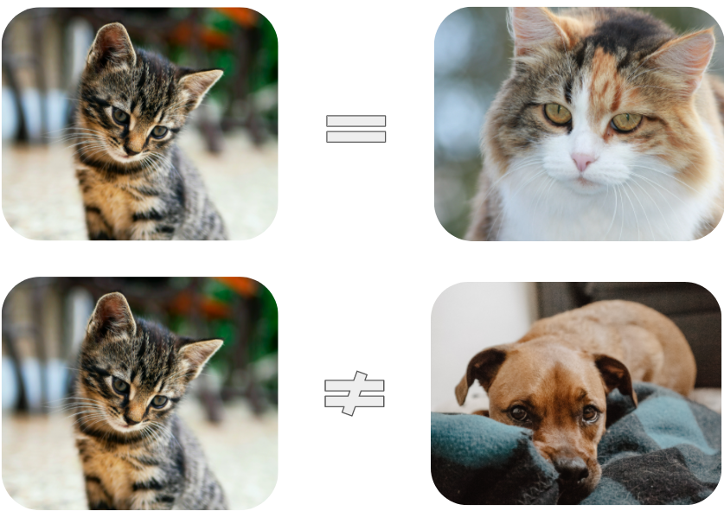
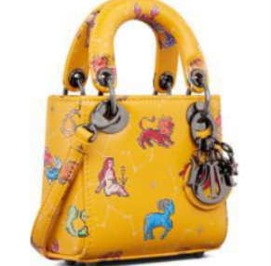
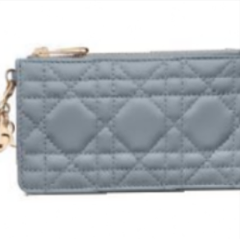
2. Finetuning ResNet with contrastive learning
Contrastive learning: Different images of a same object should have similar embeddings, while images of different objects should have disimilar embeddings.
We compare original images with augmented ones:
=
≠
Notes:
Arthur

Slide 9
The Final approach
CLIP was created by OpenAI as an innovative approach to bridge the gap
between computer vision and natural language processing.
Source
CLIP's objective in our problem is to learn visual representations from product images to enable accurate image retrieval. By leveraging zero-shot learning, it matches test images to the closest reference in the DAM dataset without requiring task-specific fine-tuning.
Objective
CLIP
Dataset
The model is trained on a massive dataset of 400 million image-text pairs using a self-supervised learning approach
CLIP uses a ViT-based transformer to process images by dividing them into fixed-size patches. Its architecture includes multiple transformer layers, attention heads, and feed-forward networks, allowing it to learn rich visual representations for each image
Architecture
Notes:
Arthur

Slide 10



In particular, we use a fine-tuned version of CLIP called:
Fashion Clip*
FashionCLIP is designed for real-world applications and is openly available
WHY
It is fine-tuned for the fashion industry, making it highly relevant to our challenge
Architecture
Uses ViT-B/32 (Vision Transformer) for image encoding.
Trained on 700k+ fashion image-text pairs (luxury retailers, online stores).
Fine-tuned to recognize nuanced fashion concepts with zero-shot learning.
Training
* https://github.com/patrickjohncyh/fashion-clip
Notes:
Arthur

Slide 11
Evaluation Method
Manual Matching
FashionCLIP Retrieval
Evaluation Criteria
Each test image was manually matched to its corresponding DAM reference image(s)
A retrieval is correct if the ground truth reference is in the Top 10 results.
Cases with multiple correct references are considered valid.
Average Cosine Similarity Score for correct vs. incorrect matches
Using the FashionCLIP model, we retrieve the Top 10 most similar images for each test image.
The model ranks results based on cosine similarity.
Some products (e.g., Black Dior Bag) had multiple valid reference images in DAM
Notes:
Rebecca

Slide 12
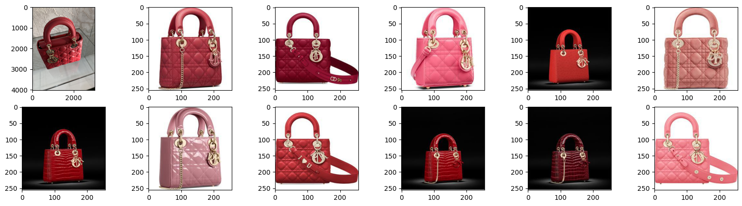
Results
Model | Top 1 accu. | Top 5 accu. | Top 10 accu.
ResNet50 | 21% | 45% | 57%
Clip | 21% | 47% | 58%
Fashion-Clip | 47% | 83% | 91%
Comparison of the different models
Qualitative results of the FashionClip model
Notes:
Rebecca

Slide 13
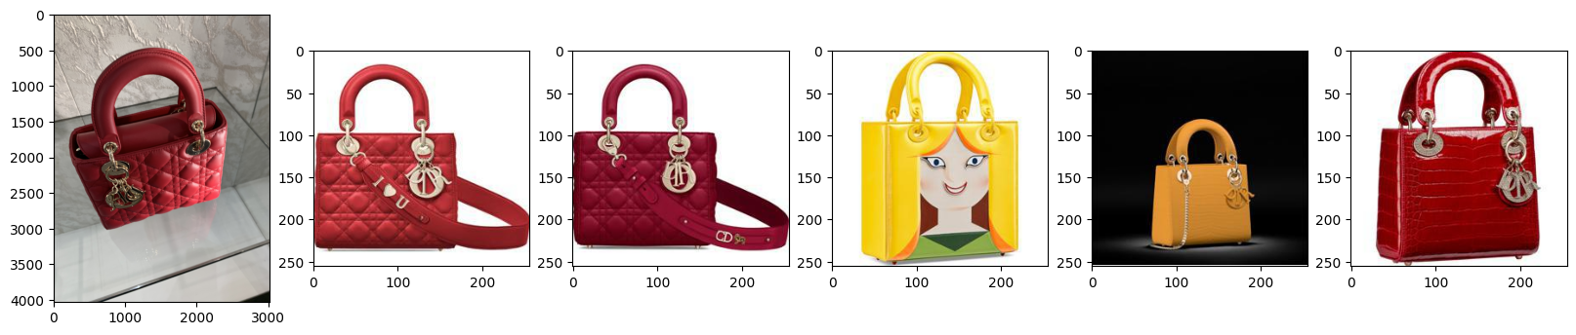
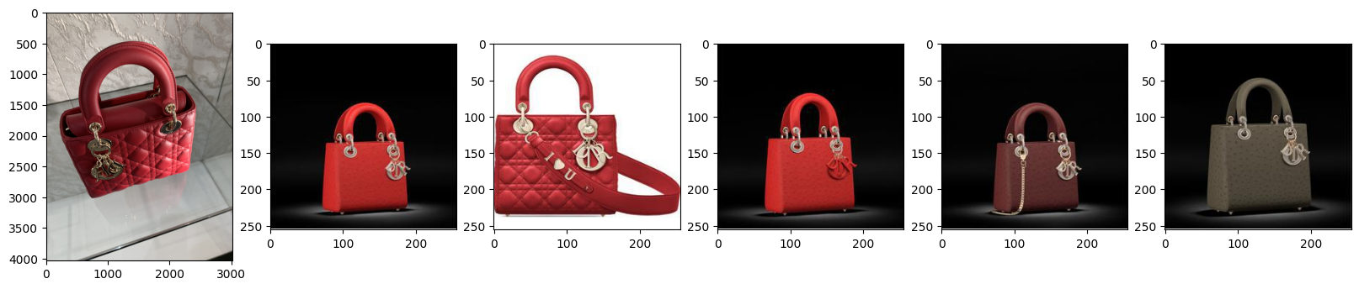
Results
Qualitative results of the ResNet model
Qualitative results of the Clip model
Notes:
Rebecca

Slide 14
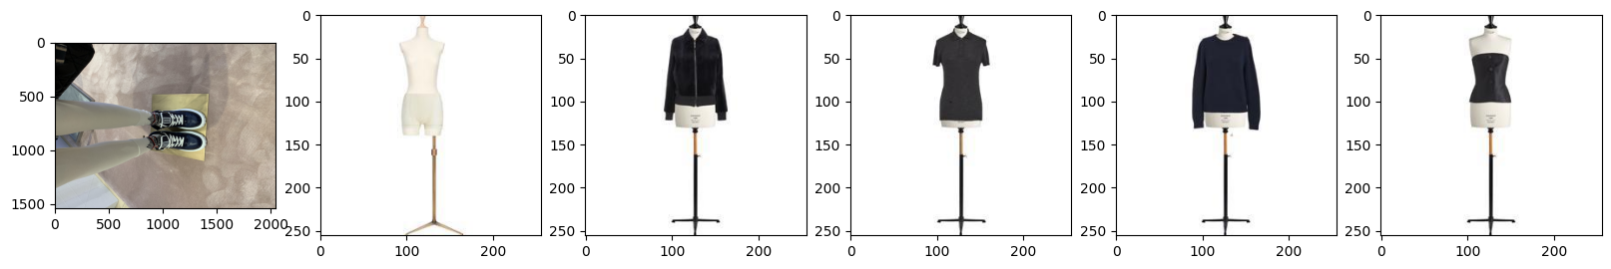
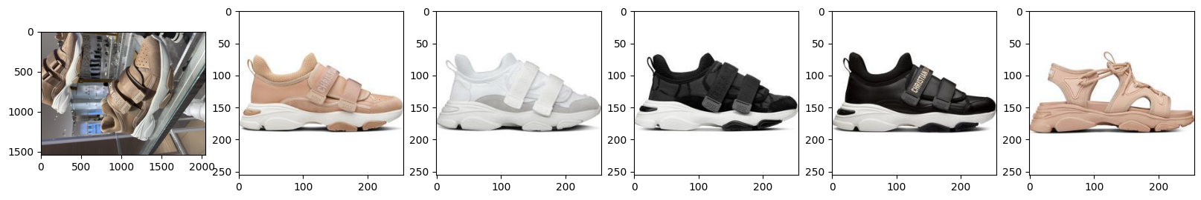
Results
Fashion Clip works well but is not perfect!
Class hallucinations:
Color hallucinations:
Notes:
Rebecca

Slide 15
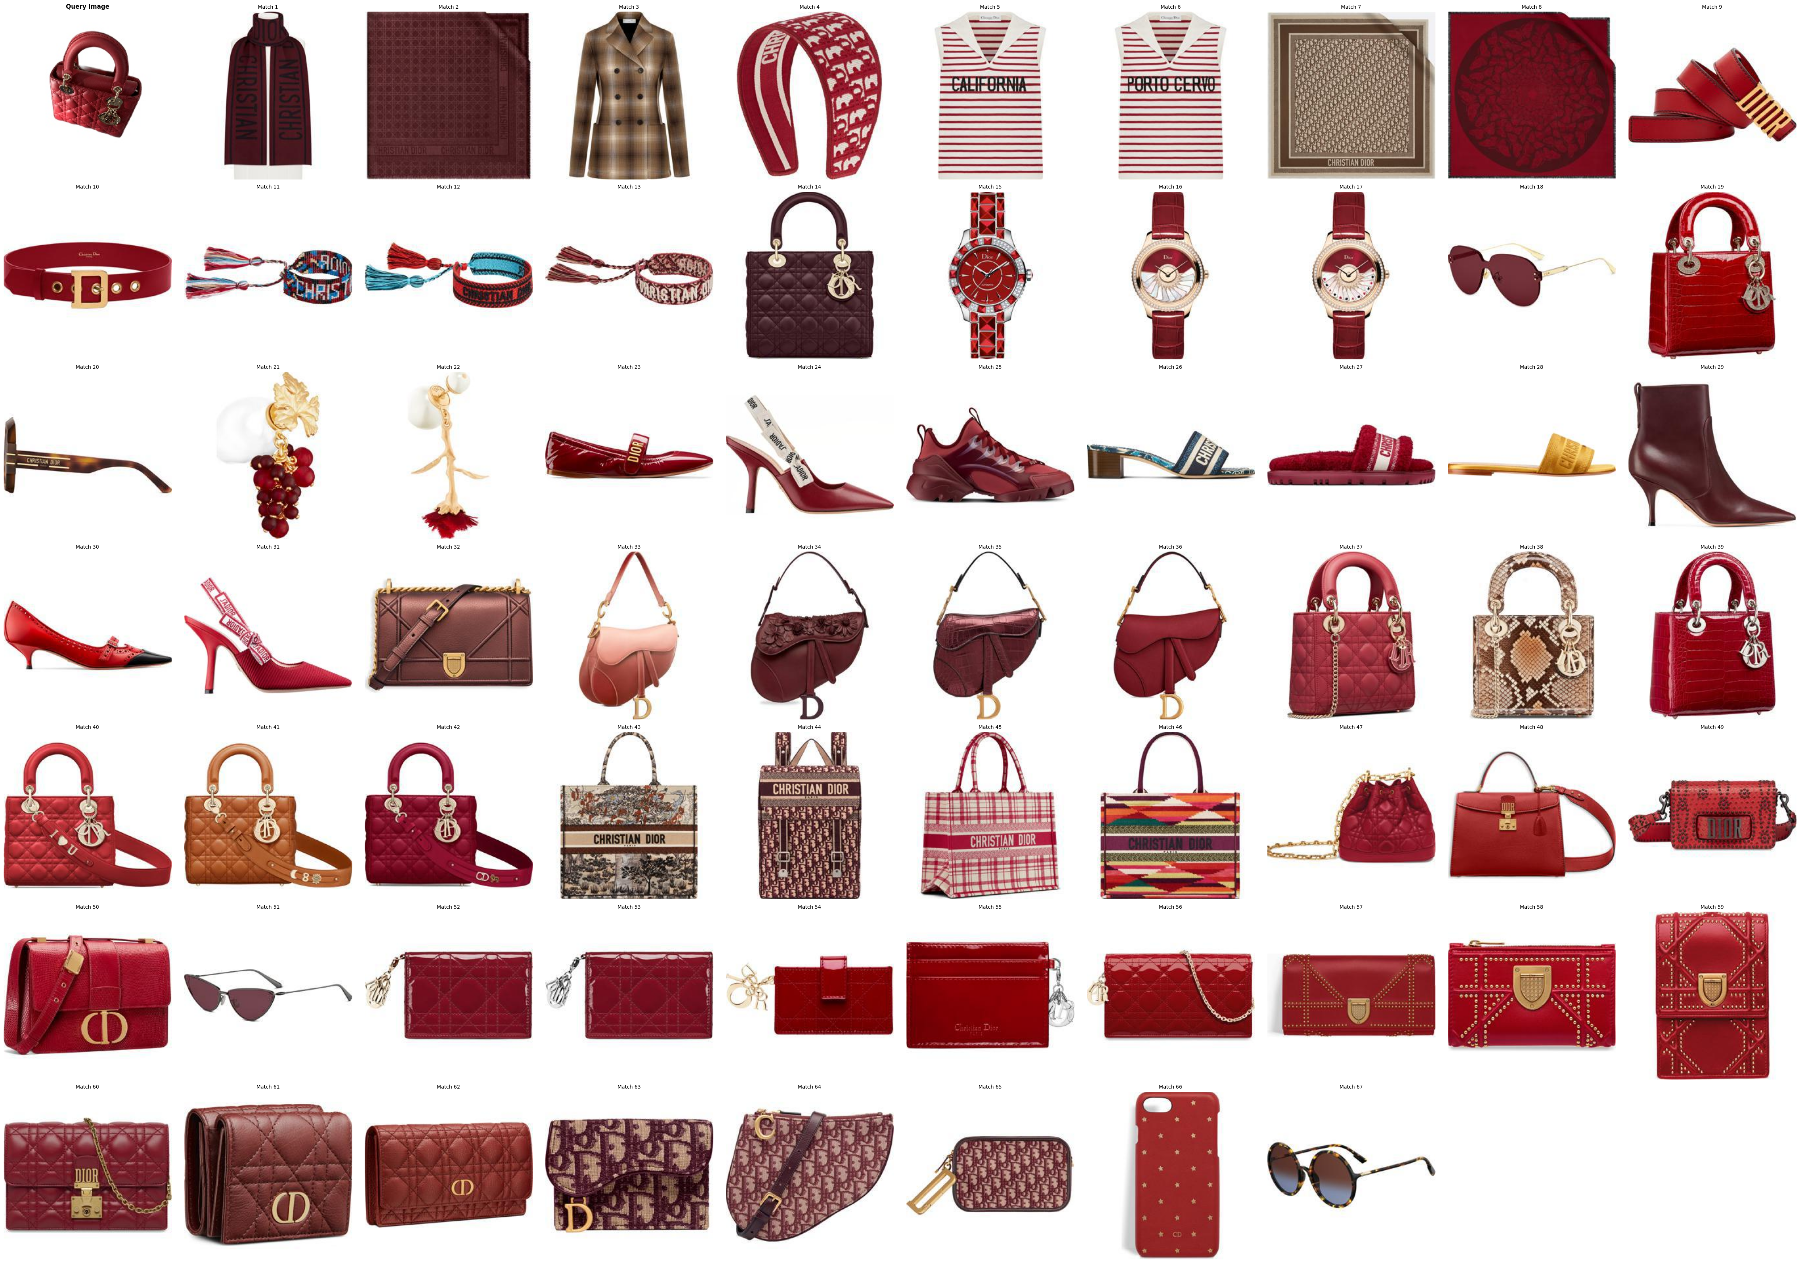
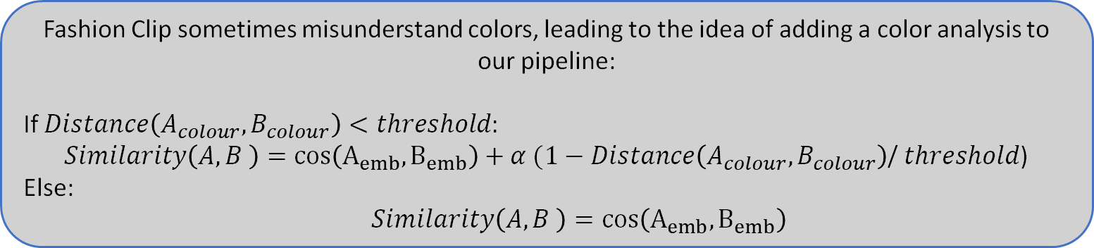
Improvements
Fashion Clip sometimes misunderstand colors, leading to the idea of adding a color analysis to our pipeline:
If $Distance\left(A_{colour},B_{colour}\right)<threshold:$
$Similarity\left(A,B \right)=cos\left(A_{emb},B_{emb}\right)+α (1−Distance\left(A_{colour},B_{colour}\right)$/ $threshold$)
Else:
$$Similarity\left(A,B \right)=cos\left(A_{emb},B_{emb}\right)$$
Model | Top 1 accu. | Top 5 accu. | Top 10 accu.
ResNet50 | 21% | 45% | 57%
Clip | 21% | 47% | 58%
Fashion-Clip | 47% | 83% | 91%
Fashion-Clip + Color | 51% | 84% | 94%
Notes:
Regazzi

Slide 16
Conclusion
The best model was :
Fashion Clip with enhanced color analysis
Successfully implemented CLIP for effective image retrieval, leveraging zero-shot learning for unseen classes.
Achieved over 94% accuracy in top 10 accuracy for the best model.
Achievements
Experiment with ensemble methods to combine multiple models for improved retrieval accuracy.
Explore additional augmentation strategies to simulate real-world conditions during training.
Future Work
Notes:
Regazzi

Slide 17
References
https://huggingface.co/docs/transformers/en/model_doc/owlv2​
​
https://github.com/NielsRogge/Transformers-Tutorials/blob/master/OWLv2/Zero_and_one_shot_object_detection_with_OWLv2.ipynb​
https://pypi.org/project/rembg/
​
https://huggingface.co/patrickjohncyh/fashion-clip​
​https://youtu.be/oEKg_jiV1Ng?si=_8I9pBSq6BseF86l​
​
Radford, A., Kim, J. W., Hallacy, C., Ramesh, A., Goh, G., Agarwal, S., ... & Sutskever, I. (2021, July). Learning transferable visual models from natural language supervision. In International conference on machine learning (pp. 8748-8763). PMLR.​
​
Melekhov, I., Kannala, J., & Rahtu, E. (2016, December). Siamese network features for image matching. In 2016 23rd international conference on pattern recognition (ICPR) (pp. 378-383). IEEE.​

Slide 18
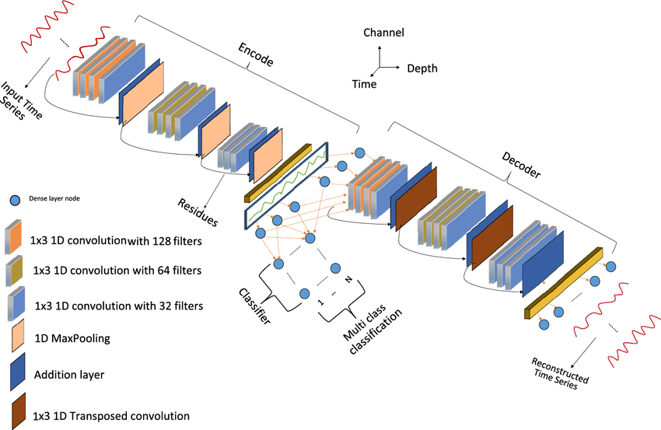
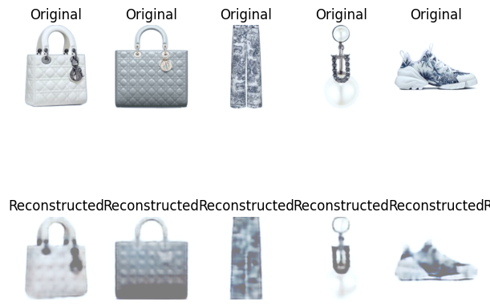
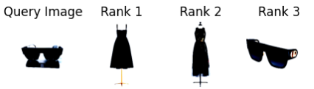
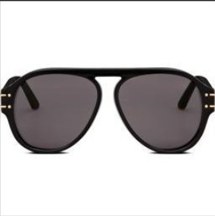
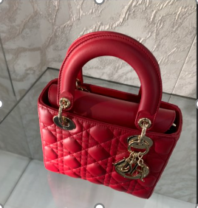
Exploring other Models for Image retrieval (ANNEXE)
Autoencoder
OwlViT (Owlv2)
It’s a vision transformer model designed for open-world object detection and image retrieval, specifically the "google/owlvit-base-patch32" variant. The model extracts image features (embeddings) using a pretrained transformer architecture, and cosine similarity is then used to match test images to DAM reference images based on visual similarity.

Slide 19
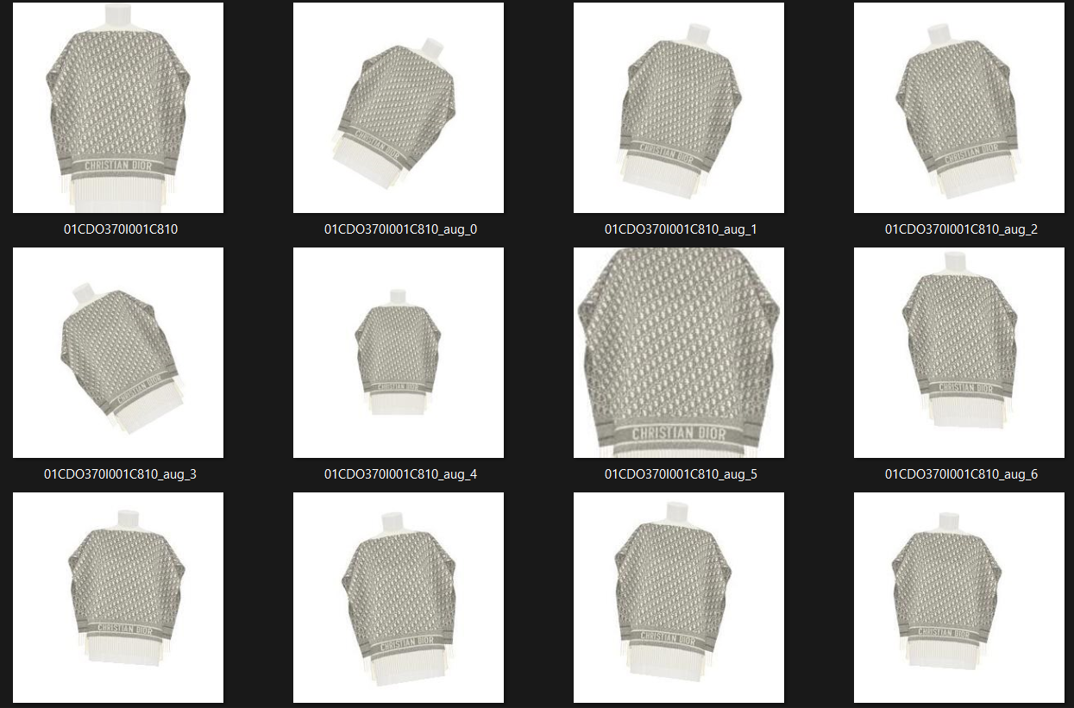
Data Augmentation

